Slide 1
Masses from experiment … and what are they good for Alexandra Gade
Monday
Introduction and methods by example:
Penning traps
Masses from time-of-flight
MR-TOF-MS
Storage ring mass spectrometry
Masses of unbound systems?!
Tuesday
Thursday

Slide 2
Outline
Introduction: Reminder of important quantities derived from masses and early concepts of mass measurements
Modern experiments: Recent examples – Physics background and experimental approach
Penning trap – Isobaric multiplet mass equation for the A=21 system (2014 – PRL)
Time-of-flight mass measurements of neutron-rich chromium isotopes up to N = 40 and implications for the accreted neutron star crust (2016 – PRC)
MR-TOF – Masses of exotic calcium isotopes pin down nuclear forces (2013 – Nature paper)
Storage ring – Identification of the Lowest T=2, J^{π} =0⁺ Isobaric Analog State in ⁵²Co and Its Impact on the Understanding of β-Decay Properties of ⁵²Ni (2016 – PRL)
Invariant mass spectroscopy – Nucleus ²⁶O: A Barely Unbound System beyond the Drip Line (2016 – PRL)

Slide 3
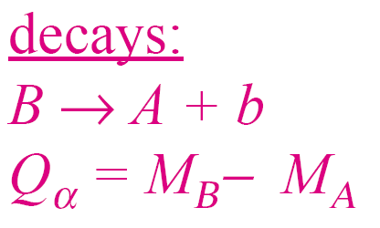
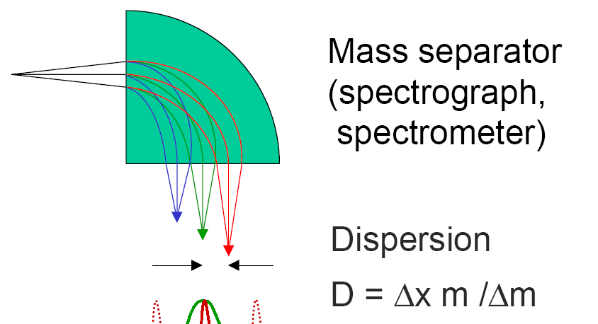
Masses – direct and indirect methods
Indirect
Past: Decay measurements and kinematics in two-body reactions
Invariant mass spectroscopy to measure ground state resonance for unbound systems
Direct
Conventional mass spectrometry
Past: Cern PS, Chalk River
Time-of-flight
spectrometer (SPEG, S800, past: TOFI)
Multi-turn (storage rings, MR-TOF MS, past: GANIL cyclotrons)
Frequency measurements
Penning traps
Storage rings
Adapted from D. Lunney

Slide 4
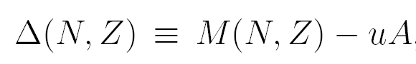
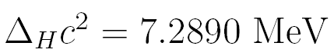
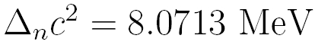
Binding energy, mass and mass excess
Mass excess:
Atomic mass unit u:
Equivalent to Δ(¹²C)=0
Binding energy:
Figure from M. Huyse

Slide 5
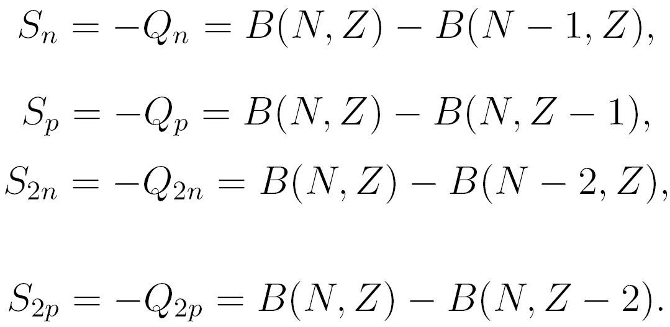
Q values and nucleon separation energies
Nucleon separation energies:
Q value of a process (^{A}Z_{i} → ^{A}Z_{f}):
Figure from M. Huyse

Slide 6
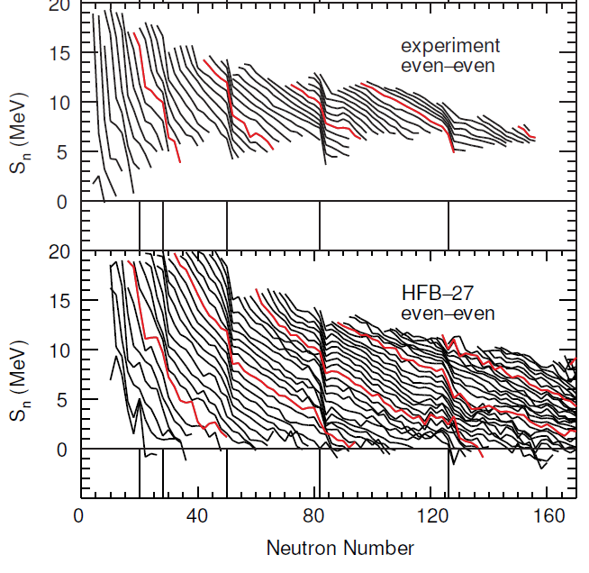
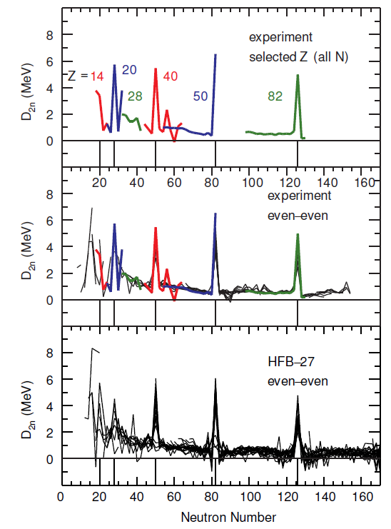
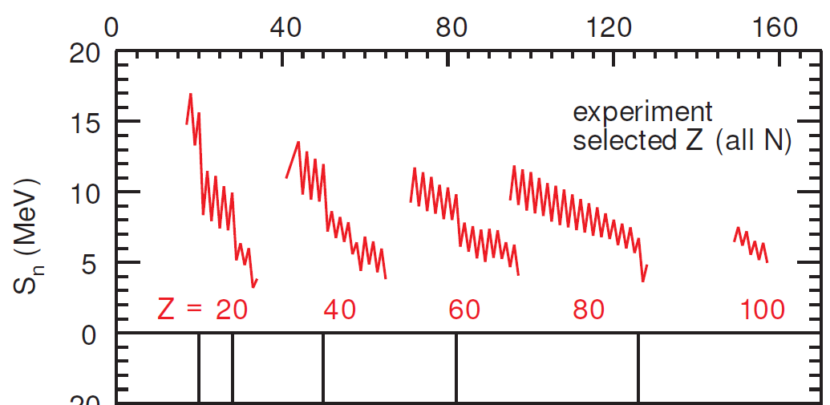
Nucleon separation energies – telltale correlations reveal shell structure and pairing
Lines connect values with the same Z
See Alex Brown’s lecture notes and week 1

Slide 7
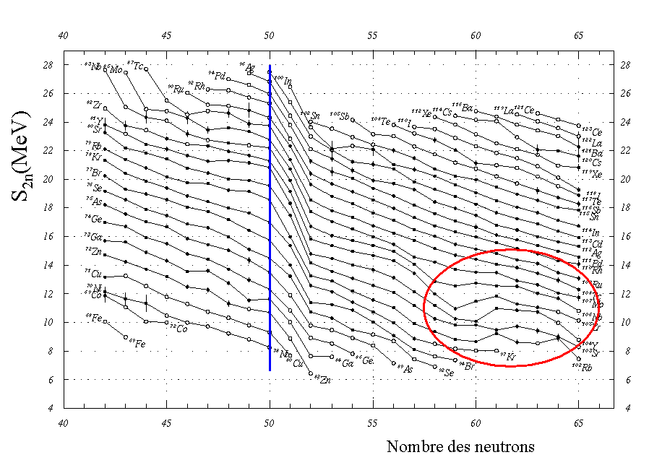
… and regions of deformation
Neutron number
magic number
deformation

Slide 8
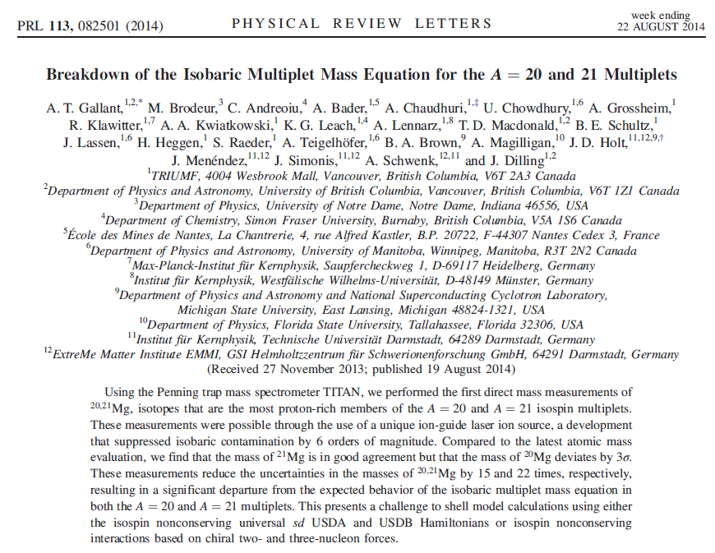
Penning traps – Masses to study isospin symmetry

Slide 9
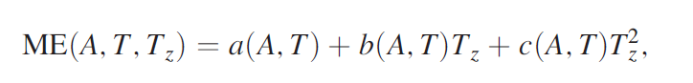
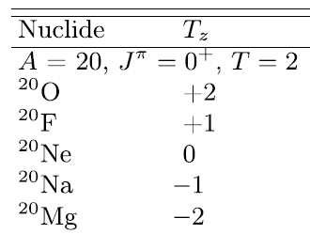
Penning traps – Masses to study isospin symmetry
The isobaric multiplet mass equation (IMME) relates the mass excess of isospin multiplet members: T_{z}=(N-Z)/2 is the projection of total isospin; a, b, and c, are coefficients that do not depend on T_{z}. The need for a cubic term, d>1 keV, would indicate a breakdown of the IMME
E.g. for A=20:
Strategy: Measure the mass of ²⁰Mg precisely, extract ME, and fit the five ME(A=20, T=2, T_{z}) with the IMME to evaluate need for significant cubic (or quartic) terms
Precise ground-state mass was unknown until paper
T.S. Gallant et al., PRL 113, 082501 (2014)

Slide 10
Penning traps – Masses to study isospin symmetry
Mass measurements of ^{20,21}Mg were performed at the TITAN Penning trap facility at TRIUMF
TRIUMF is an ISOL facility. ^{20,21}Mg were produced by bombarding a SiC target with 480 MeV protons (spallation) and extracted from the target and made into a very low-energy ion beam (special purification and laser techniques were needed to reduce isobaric contaminants in the extracted beam)
Each beam was cooled and bunched and injected into a Penning trap for mass spectrometry
T.S. Gallant et al., PRL 113, 082501 (2014)

Slide 11
Mass measurements with Penning traps
B
Mass measurement via deter-mination of cyclotron frequency
from characteristic motion of stored ions
q/m
end cap
PENNING trap
Strong homogeneous magnetic field of known strength B provides radial confinement
Weak electric 3D quadrupole field provides axial confinement
ring
electrode
Ion source

Slide 12
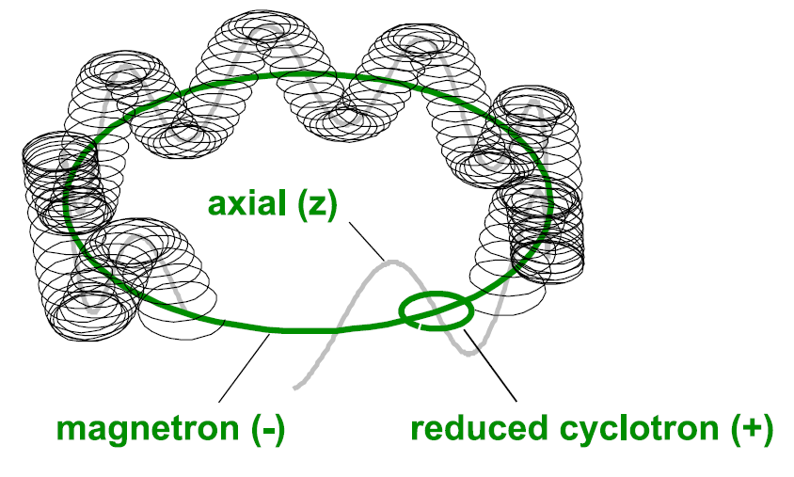
Mass measurements with Penning traps
Motion of an ion is the superposition of three characteristic
harmonic motions:
axial motion (frequency f_{z})
magnetron motion (frequency f–)
modified cyclotron motion (frequency f₊)
The frequencies of the radial motions obey the relation
Excite the cyclotron motion with multipolar RF (Goal: excite the cyclotron motion to resonance)
Transform radial to axial energy (gradient dB/dz) and eject ions
Typical frequencies
q = e, m = 100 u,
B = 6 T
⇒ f₋ ≈ 1 kHz
f₊ ≈ 1 MHz
Measure time of flight (TOF) - the shorter TOF, the closer is the excitation frequency to the resonance
This is done relative to a calibration mass to cancel out drifts in the magnetic field
Adapted from K. Blaum

Slide 13
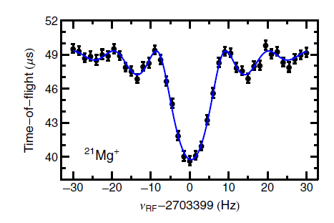
Mass measurements with Penning traps
Eject thermalized ions from buncher
Capture ions in Penning trap
Perform RF excitation
ME=10 903.85 (74) keV
Eject ions and measure TOF
δm=740 eV
T.S. Gallant et al., PRL 113, 082501 (2014)

Slide 14
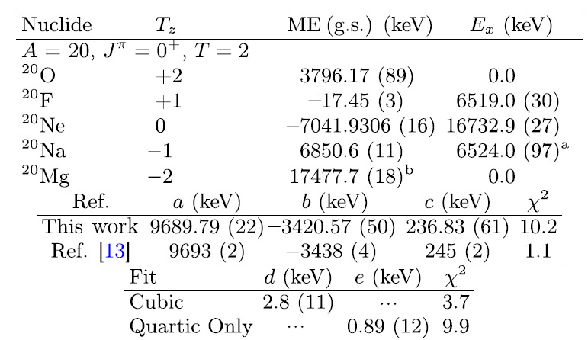
Penning traps – Masses to study isospin symmetry
For A=20, cubic and quartic extension of the IMME equation were found to describe the mass excess better than the quadratic form → breakdown of IMME
T.S. Gallant et al., PRL 113, 082501 (2014)
Not shown here, for the A=21 system, a breakdown of the IMME was observed as well.
However: A=20 IMME was restored in 2015 through a new energy measurement of the ²⁰Na, J=0⁺, T=2, state of E_{x}=6498.4±0.2±0.4 keV [B. E. Glassman et al., PRC 92, 042501 (R) (2015)]

Slide 15
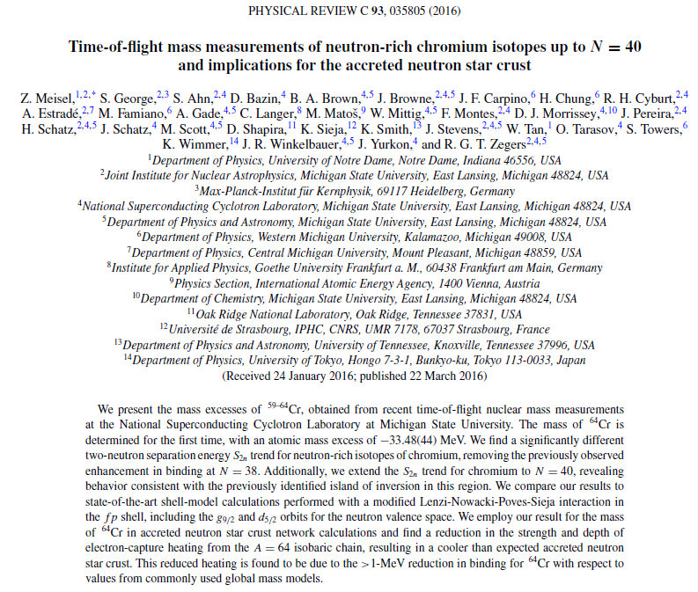
Time-of-flight – Masses as input for astrophysical modeling

Slide 16
Time-of-flight – Masses as input for neutron star modeling
A prevalence of A=64 material is expected on the surface of neutron stars and, therefore, in the outer neutron star crust
The trend in nuclear masses for the A=64 isobaric chain strongly impact the depth and strength of electron capture reactions that heat and cool the outer crust, altering its thermal profile
This thermal profile impacts astronomical observables such as the ignition of type I X-ray bursts and superbursts, neutron star cooling, and potentially gravitational wave emission
Strategy: Measure the mass of ⁶⁴Cr (the most neutron-rich A=64 isobar so far) and probe effect in neutron star crust network calculations
Z. Meisel et al., PRC 93, 035805 (2016)

Slide 17
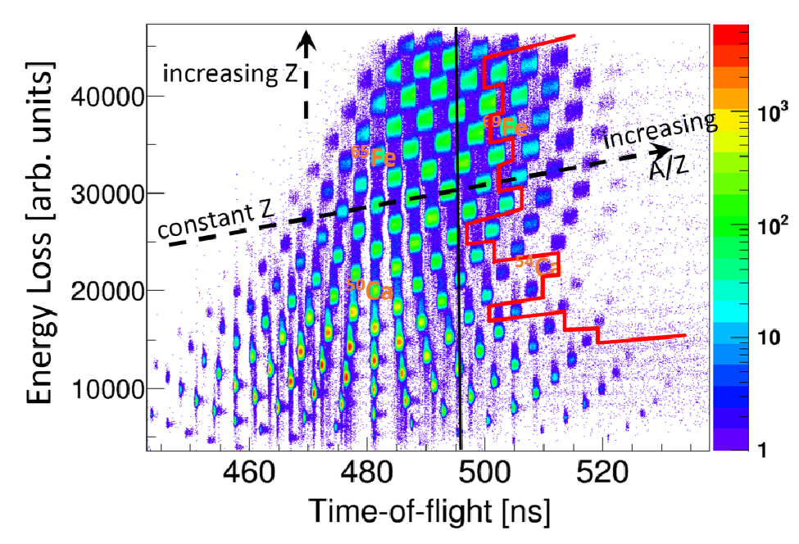
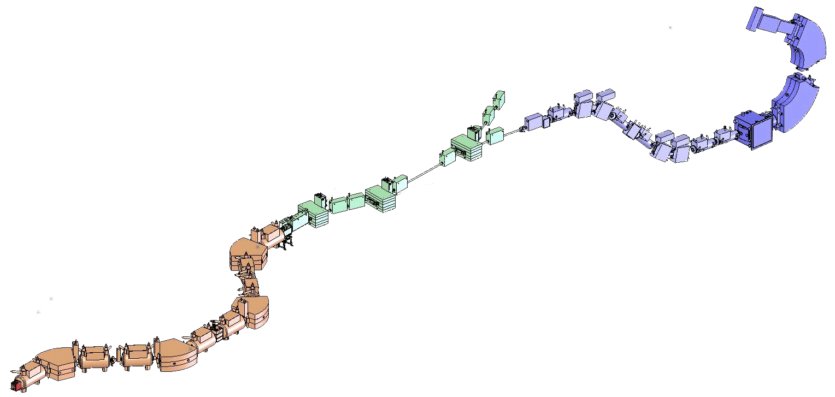
TOF mass measurements – Spectrographs at NSCL
TOF mass measurements on neutron-rich isotopes: δm = 0.4-0.5 MeV for A~60
TOF stop
58m flight path
A1900+S800 at NSCL
Measured many masses simultaneously (150!)
Mass accuracy: ΔME=400-500 keV (should be possible to get to 200 keV)
Beam rate: few particles/second
Works for very short-lived nuclei
Bρ=γm/q (dx/dt)
Measure Bρ and TOF
TOF start
Notes:
TOF ~ 500ns
D TOF=100ps (resolution) and centroid determination to 1ps

Slide 18
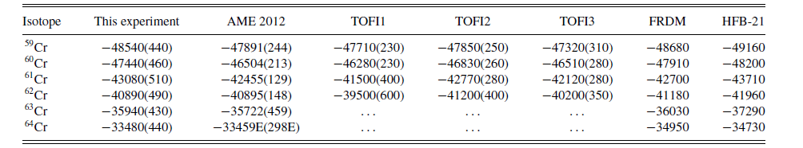
TOF mass measurements – Results for Cr isotopes
Results for the mass excess:
For ⁶⁴Cr, found a 1.47 and 1.25 MeV reduction in binding with respect to the often-used global mass models FRDM and HFB-21, respectively
This reduction in binding energy leads to a reduced odd-even staggering near Cr in the A=64 isobaric chain
Z. Meisel et al., PRC 93, 035805 (2016)
Notes:
TOF ~ 500ns
D TOF=100ps (resolution) and centroid determination to 1ps

Slide 19
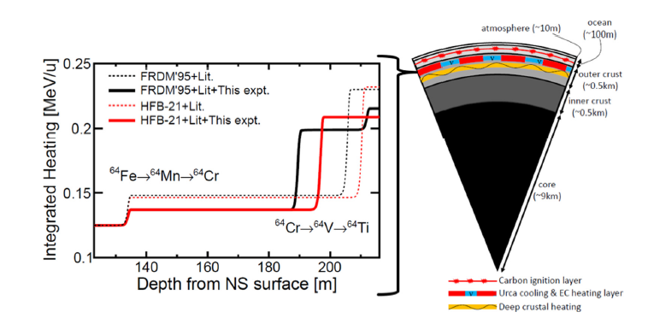
What does this mean for the neutron star crust?
This causes a reduction in the magnitude and depth of electron-capture heating associated with ⁶⁴Cr, a major heat source in the outer crust of accreting neutron stars as compared to scenarios that use the global model input
Z. Meisel et al., PRC 93, 035805 (2016)
Notes:
TOF ~ 500ns
D TOF=100ps (resolution) and centroid determination to 1ps

Slide 20
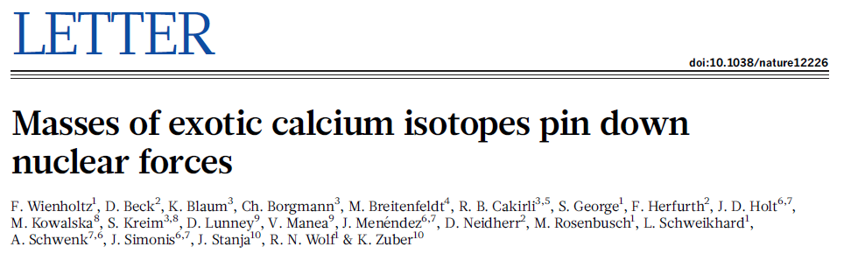
MR-TOF mass measurements

Slide 21
MR-TOF mass measurements of neutron-rich Ca isotopes
Neutron-rich nuclei are sensitive to ingredients of the nuclear force not accessible at stability
The Ca isotopic chain has been a favorite testing ground for ab-initio modelers to benchmark their many-body approaches and input forces
Neutron-rich Ca isotopes harbor three (sub-)shell closures: N=28, N=32 and N=34
No mass measurements for ^{53,54}Ca prior to ISOLDE work
Strategy: Measure the masses of ^{53,54}Ca and compare to nuclear structure calculations, ab-initio, CI, and DFT

Slide 22
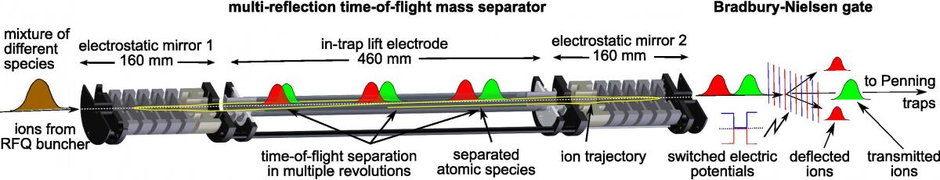
MR-TOF mass measurements
^{51,52,53,54}Ca were produced at CERN/ISOLDE in proton-induced fission on a uranium carbide target
The Ca isotopes were selected through a laser-ionization scheme and transported – as a 30 keV singly-charged ion beam – to the ISOLTRAP setup
The ^{51,52}Ca masses were measured with the ISOLTRAP Penning trap setup
^{53,54}Ca had too low production rates for Penning trap needs and their masses were measured with a multi-reflection time-of-flight mass separator
F. Wienholtz et al., Nature 498, 346 (2013)

Slide 23
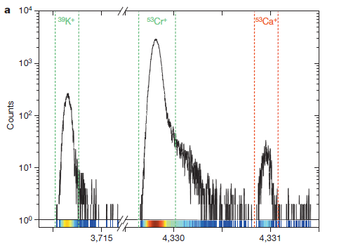
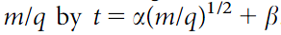
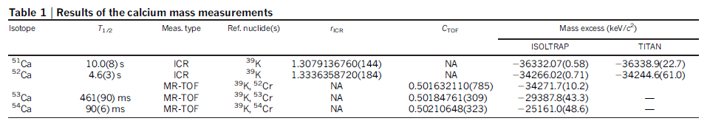
MR-TOF mass measurements
The ToF of the nuclei of interest is measured relative to the ToF of reference nuclei (³⁹K, ⁵³Cr)
Apparatus specific constants are determined from the reference masses and used to extract the mass of the unknown
ToF (μs)
F. Wienholtz et al., Nature 498, 346 (2013)

Slide 24
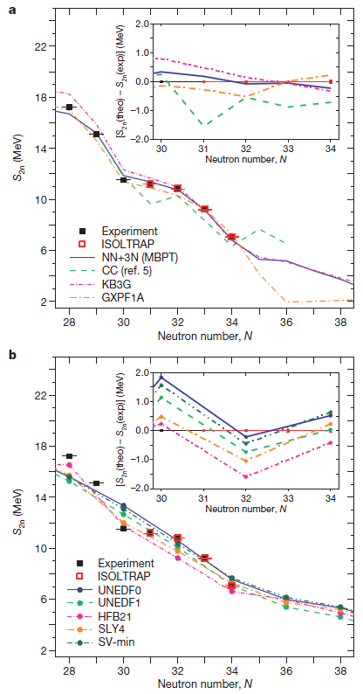
Ca masses – at the end of the day
DFT seems unable to capture the (sub-)shell effects while being more consistent with each other upon extrapolation
The trend of the S2n values deduced from the masses agree well with many-body perturbation theory with NN and 3N forces and CI shell model with veteran effective interactions
Some models deviate when extrapolating
F. Wienholtz et al., Nature 498, 346 (2013)

Slide 25
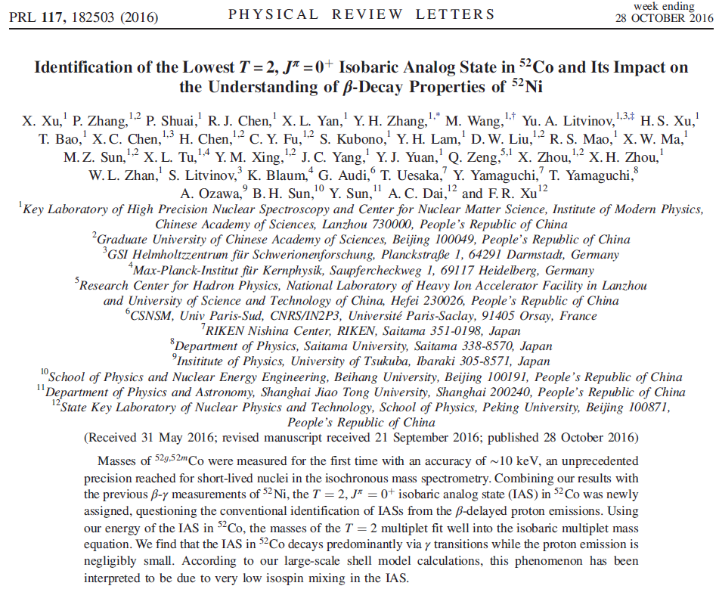
Masses from storage rings

Slide 26
⁵²Co ground-state and isomer mass determined to 10 keV
First measurement of the ground-state and isomer mass of ⁵²Co
Outcome: The new mass and isomer energy allowed to recalculate the energy of the T=1, J=0⁺ isobaric analog state (IAS) in ⁵²Co, correcting an alleged breaking of the IMME
Method: The masses of ⁵²Co in the ground state and the low-lying isomer were measured in one shot with isochronous mass spectrometry with the Cooler Storage Ring (CSR) at HIRFL in Lanzhou

Slide 27
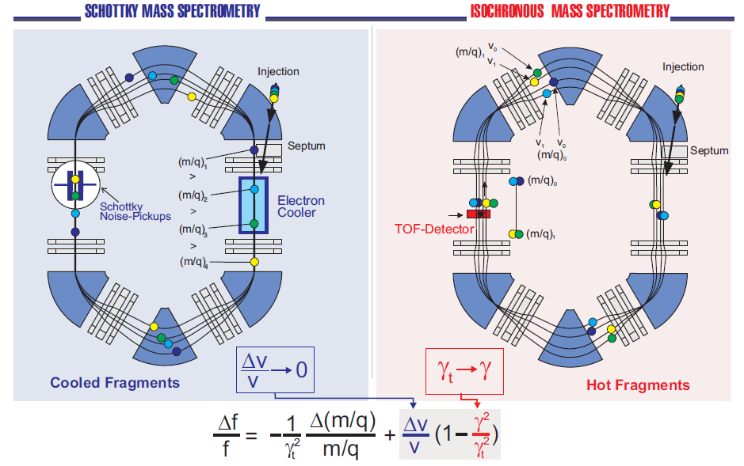
Mass measurements in the ESR storage ring at GSI
F. Bosch, Lect. Notes Phys. 651, 137 (2004)
T_{1/2}> 1s
T_{1/2}> 10 μs
γ_{t}: relative change in path length by turn relative to change in Bρ
Notes:
ESR at GSI consists of 6 dipole and 20 quadrupole magnets (108m circumference). Ring is operated in two different modes and in both modes the mass measurement is in both modes based on a measurement of the revolution frequencies of stored exotic ions. The equation below quantifies the frequency differences of two ion species that have a velocity difference dv and a m/q difference dm/q

Slide 28
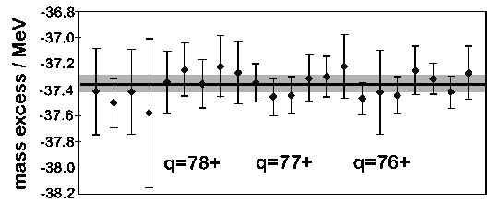
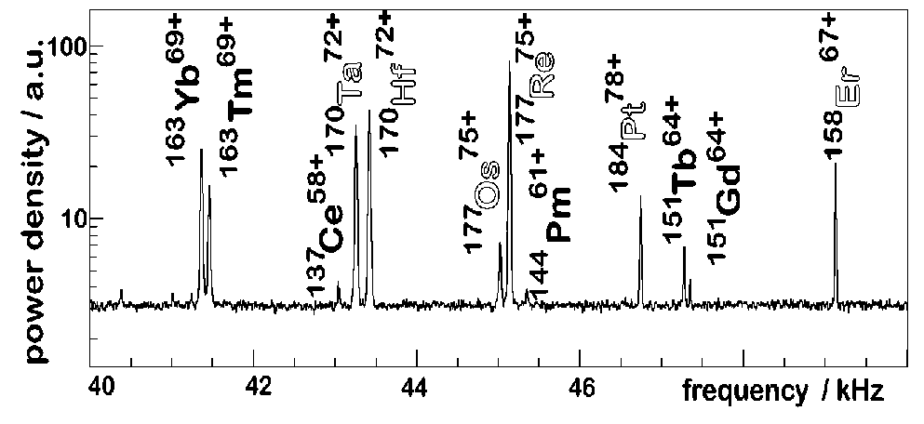
Mass measurements in storage rings Schottky mass spectrometry (pioneered at GSI)
Schottky spectrometry in storage ring (GSI), e.g. ¹⁸⁴Pt
Mass excess for ¹⁸⁴Pt as determined in several runs using different reference isotopes and in different ionic charge states q. (dm/m=5 10⁻⁷ )
T. Radon et al., PRL 78, 4701 (1997)
Notes:
Beam cooling: stochastic cooling (pre-cooling) followed by electron cooling (~few seconds). Electron cooling at ESR: electrons have almost same mean beam velocity as ion beam but much smaller velocity spread.
Schottky: Dv=0 frequency of revolution measured by pick-up plates (Schottky noise pickup, ion with charge q induces a signal proportional to q^2 on the pickup plates, signals are sampled and Fourier transformed to )

Slide 29
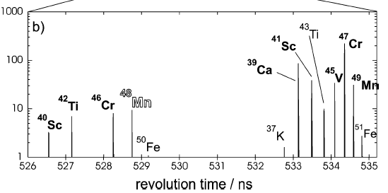
Mass measurements in storage rings Isochronous mass spectrometry (pioneered at GSI)
Accuracy of δm= 100-500 keV was achieved (lifetimes ~ 100 ms)
J. Stadlmann et al., PLB 586, 27 (2004)
Notes:
Complementary approach for uncooled, shorter-lived ions, revolution frequency is stationary for given m/q. Here, revolution times are measured via TOF technique. Ions cross thin metallized carbon foil. Delta electrons are created which are guided to detector by magnetic field. Ion-by-ion time stamp. 30 –50 simultaneously stored ions.
The duration of the cooling process is a limitation for the access of very short-lived stored nuclei. This restriction can be circumvented by tuning the storage ring to its transition energy (isochronous mode). In this special ionoptical mode the revolution time is independent of the velocity spread because the faster ions of each isotope are guided on longer trajectories to preserve a constant revolution time [17]. The isochronicity condition is strictly fulfilled only for one mass-to-charge (m/q) ratio in a narrow Bρ range.

Slide 30
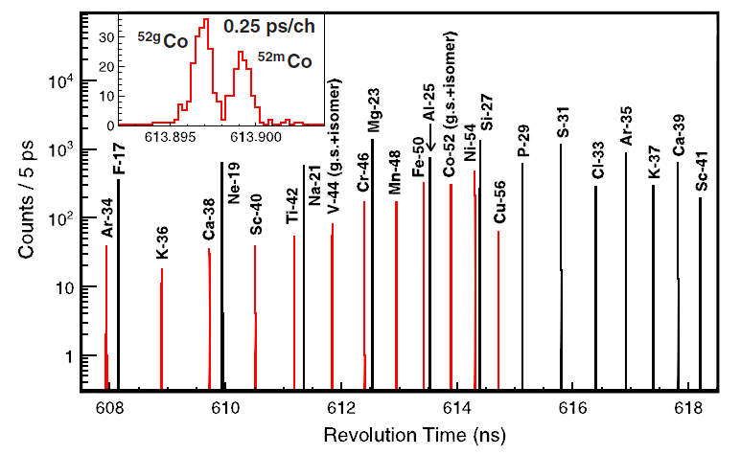
⁵²Co ground-state and isomer mass determined to 10 keV
⁵²Co was produced by fragmentation of a 468 MeV/u ⁵⁸Ni primary beam and injected at γ=γ_{t} into the storage ring
The revolution time was measured and the mass extracted from a calibration function deduced from known calibration masses
X. Xu et al., PRL 117, 182503 (2016)

Slide 31
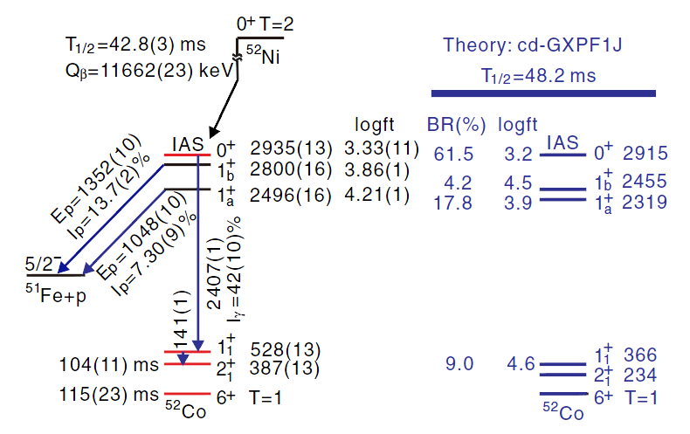
⁵²Co ground-state and isomer mass determined to 10 keV
X. Xu et al., PRL 117, 182503 (2016)
Isomer energy determined to 387(13) keV. IAS corrected 2935(13) keV from adding the 114-2407 keV γ-ray cascade
Previously, the IAS energy was determined from the 1352 keV proton decay to ⁵¹Fe → the storage ring work argues that the proton emission occurs from a 1⁺ state rather than the IAS
This restored the validity of the IMME for the T=2, J=0⁺ A=52 system

Slide 32
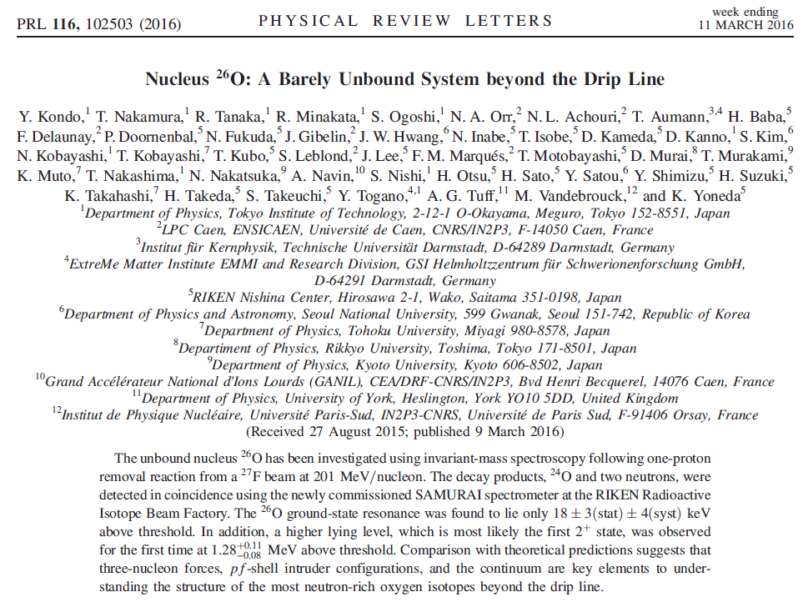
Masses (resonance energies) of unbound systems
Notes:
TOF ~ 500ns
D TOF=100ps (resolution) and centroid determination to 1ps

Slide 33
Energy of ground-state resonances of unbound systems
The location of the nucleon driplines is a fundamental question, answering the key question: What combinations of protons and neutrons can be made into a bound system
One approach of proving the existence of a nucleus is to produce and detect it – but how do we show that something is unbound (aside from measuring an infinitely long time …)?
Strategy: Deduce its ground-state resonance energy by measuring the decay energy of the many-body breakup, e.g. ²⁵O→²⁴O+n or ²⁶O→ ²⁴O+n+n

Slide 34
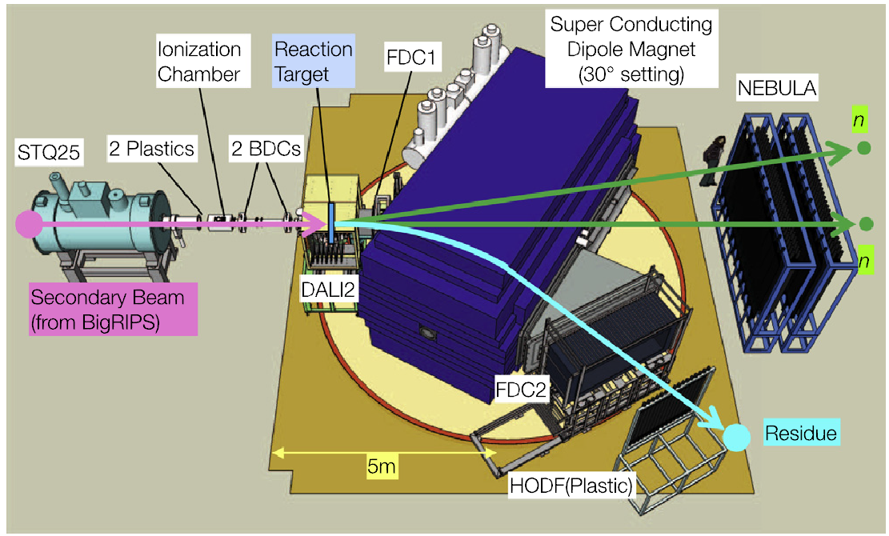
Masses (resonance energies) of unbound systems
Strategy: measure 4-momentum vectors of all breakup products and extract decay energy
²⁶F and ²⁷F at ~200 MeV/u were produced by projectile fragmentation of 345 MeV/u ⁴⁸Ca primary beam
²⁵O and ²⁶O were produced from ²⁶F and ²⁷F by one proton removal reactions and they breakup was studied with the SAMURAI spectrometer
H. Otsu et al., NIM B 376, 175 (2016)
Notes:
TOF ~ 500ns
D TOF=100ps (resolution) and centroid determination to 1ps

Slide 35
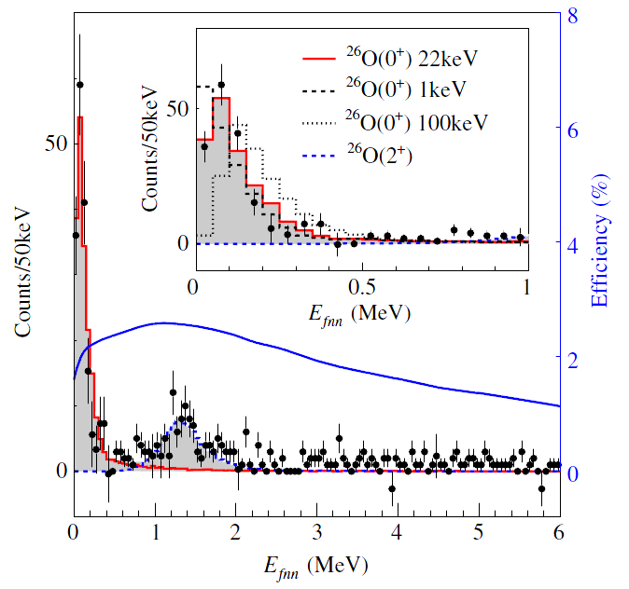
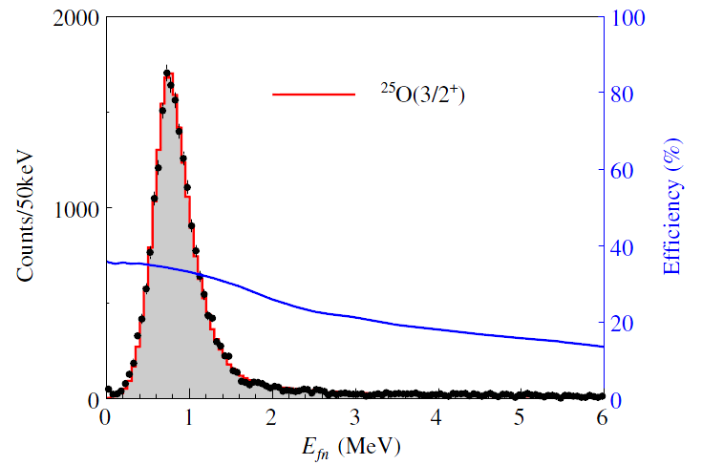
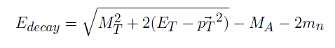
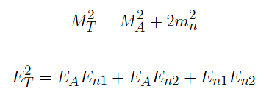
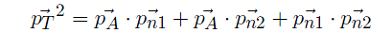
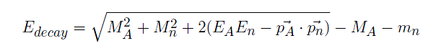
Masses (resonance energies) of unbound systems
²⁶O is produced and breaks up into ²⁴O and two neutrons
Strategy: measure 4-momentum vectors of all breakup products and extract decay energy
Y. Kondo et al., PRL 116, 102503 (2016)
²⁵O is produced and breaks up into ²⁴O and one neutron
Notes:
TOF ~ 500ns
D TOF=100ps (resolution) and centroid determination to 1ps

Slide 36
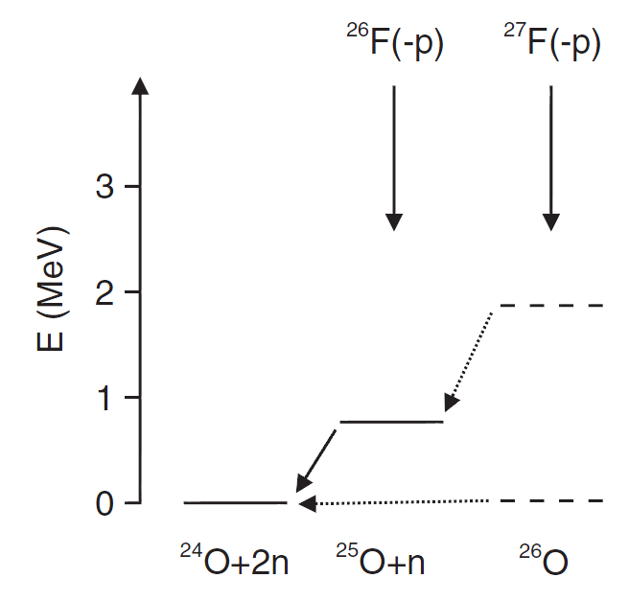
^{26,25}O relative to stable ²⁴O
(2⁺)
1.28 MeV
3/2⁺
750 keV
0⁺
0⁺
18±3±4 keV
Red: Y. Kondo et al., PRL 116, 102503 (2016)

Slide 37
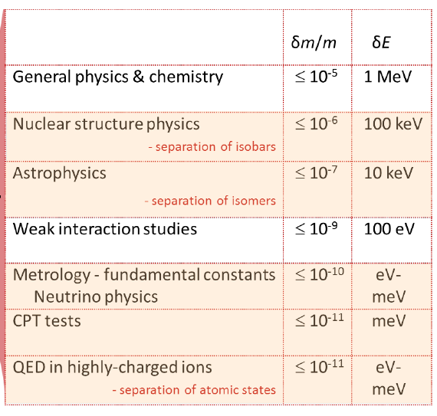
Summary – what are masses good for?
Different experimental approaches have different sensitivities
Adapted from Klaus Blaum

Slide 38
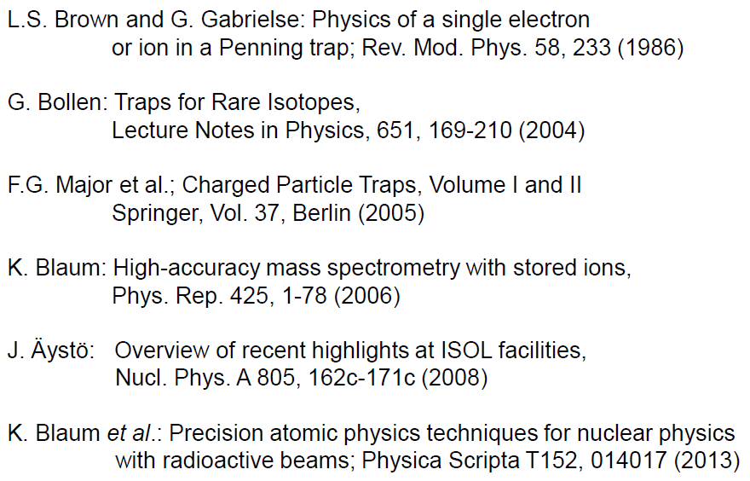
Related review articles
F. Bosch: Measurements of mass and beta lifetime of stored exotic nuclei, Lecture Notes in Physics 651, 137 (2004)

